Slide 1
Linear Algebra
Group 15

Slide 2
Members
林伯蔚 ฅ^•ﻌ•^ฅ
管培勛 ฅ^•ﻌ•^ฅ
巫廷翰 ฅ^•ﻌ•^ฅ

Slide 3
Outline
Motivation
Methods and Resources
Evaluation and Discussion
Live DEMO ( Debug ψ(｀∇´)ψ )

Slide 4
Motivation

Slide 5


The Problem We Want to Solve
When sending photos, we may consider it insecure since the underlying network may be unsafe.
Therefore, we make a bot to help people encrypt confidential photos with specified password and transfer them to others securely.
From: wiki
From: inside.com.tw

Slide 6
Methods and Resources

Slide 7
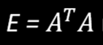
Linear Algebra Methods
Images are matrices that stores color values an pixel per entry.
We multiply an image by an invertible matrix to encrypt it.
is an invertible matrix if A has linearly independent columns
User-specified password is expanded by a large matrix into a long key
The key is used to generate the invertible matrix

Slide 8

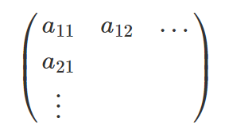
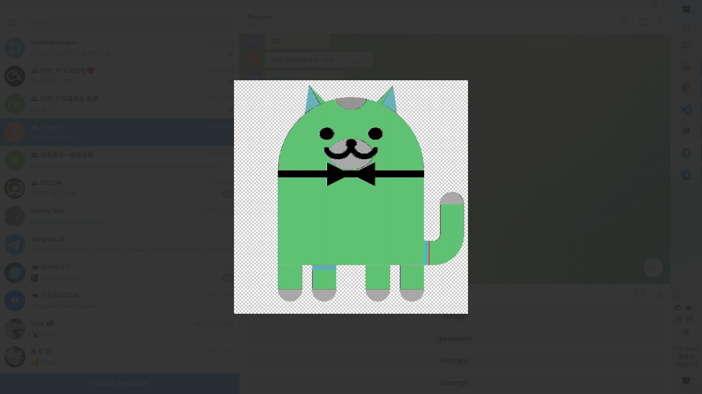
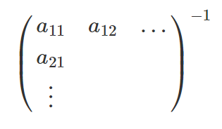
[Image] X [Encryption matrix]
*
=
=
*

Slide 9
Resources
Numpy
Scipy
Telegram bot Python API

Slide 10
Evaluation and Discussion

Slide 11
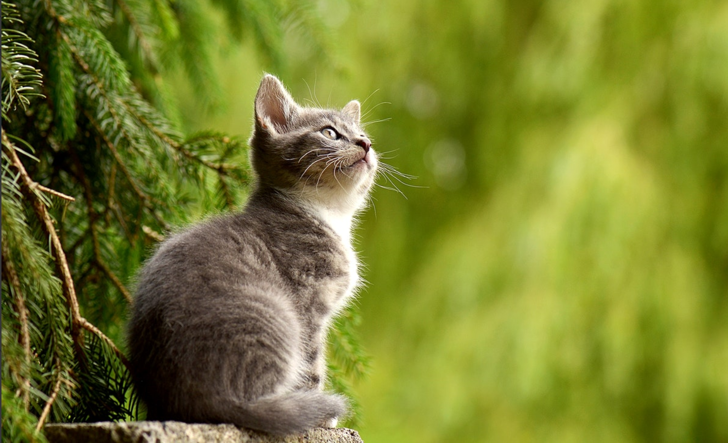

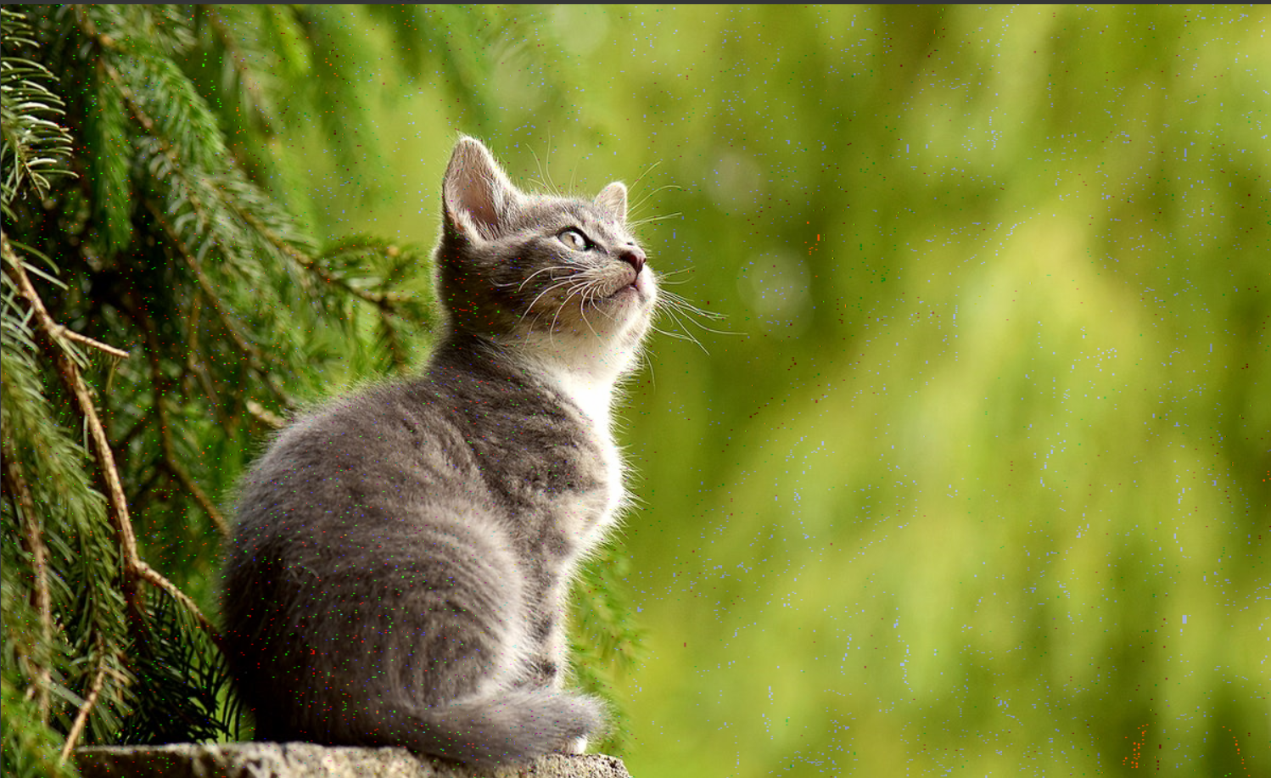
Evaluation
Original
Encrypted
Decrypted

Slide 12
Discussion
What can be improved:
Every user depends on this bot
Single point failure
Everyone should install Telegram
There are some differences between the original image and the decrypted image.

Slide 13
Demo Time

Slide 14

https://github.com/SiriusKoan/NYCU-LA-final-project Codes are available !!!

